Slide 1


IoT based Air Pollution Monitoring And Purifying System
Presented By-
Anurag Verma (2004110)
Rachak Sinha (2004124)
Siddharth Gautam(2004133)
Snehal Raj (2004134)
Guided By-
Prof. Tapaswini Samant
School of Electronics Engineering

Slide 2

Project Overview
In this project we are going to make an IoT Based Air Pollution Monitoring and Purifying System in which we will monitor the Air Quality over a webserver using internet and will trigger a alarm and also activate the Portable purifier to purify the air of the surrounding when the air quality goes down beyond a certain level.
It will show the air quality in PPM (Parts Per Million) on the LCD and as well as on webpage so that we can monitor it very easily.

Slide 3
Relevancy
Compared to other air quality monitoring systems, this project is highly efficient and low-cost due to the integration of a sensor with the Internet of Things (IoT) and ESP 32 microcontroller.
The use of the portable purifier helps us to improve the surrounding air quality instantly.There is no such feature available in the previous projects.
The use of embedded C software makes maintenance easy, and the system can also be easily modified as per the user's requirements.

Slide 4
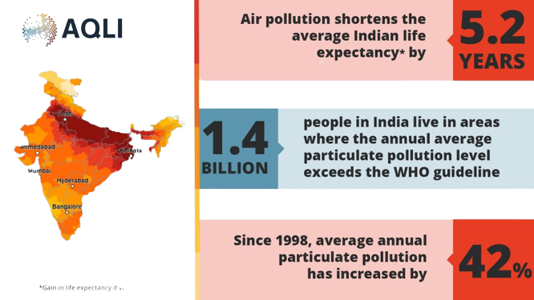
Objective
Air pollution has become major problem for every nation, whether it is developed country or developing country.
Health issue have been growing rapidly especially in urban areas of developing countries.
It is necessary to supervise air quality and keep it under control for a superior future and healthy living for all.

Slide 5
Literature Survey
Air Quality Monitoring System
International Journal of Computational Science and Engineering.ISSN 2249-4251 Volume 9, Number 1 (2019), pp. 1-9© Research India Publications
http://www.ripublication.com
Air Quality Monitoring System
International Journal of Engineering Research & Technology (IJERT) ISSN: 2278-0181 Published by, www.ijert.org
NCCDS - 2021 Conference Proceedings
A SURVEY PAPER ON AIR POLLUTION MONITORING USING IOT
IJARIIE-ISSN(O)-2395-4396

Slide 6
Project Description
An IoT based air pollution monitoring system using Microcontroller board is a project that uses Gas sensors to measure air quality data and sends it to an online platform for analysis and display.
It consists of an Microcontroller board, Gas sensors, a Wi-Fi module, an online platform, and a power source.
The system collects data from the sensors, transmits it to the cloud using the Wi-Fi module, and displays it in real-time on the online platform.
It is useful in applications such as smart cities, traffic management, and industrial monitoring.

Slide 7
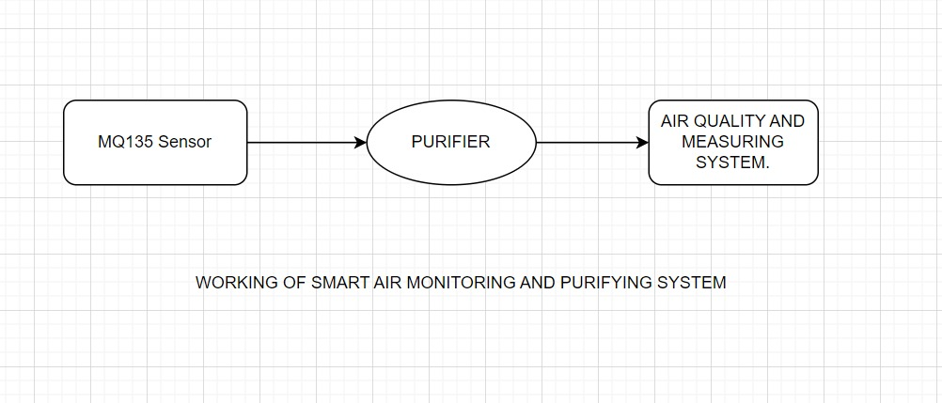
Block Diagram

Slide 8
Project Requirement
Resistor | 220 ohm,1k ohm
Potentiometer | 10k ohm preset potentiometer
Buzzer | 5v piezoelectric active buzzer
Breadboard | GL-20 840 points breadboard
LCD display | 16x2 LCD Display with I2C integration
Gas Sensor | MQ135 air quality gas sensor
Transceiver | Wi-fi Transceiver Module
Micro-controller Board | ESP32 microcontroller, Arduino IDE programming software.

Slide 9
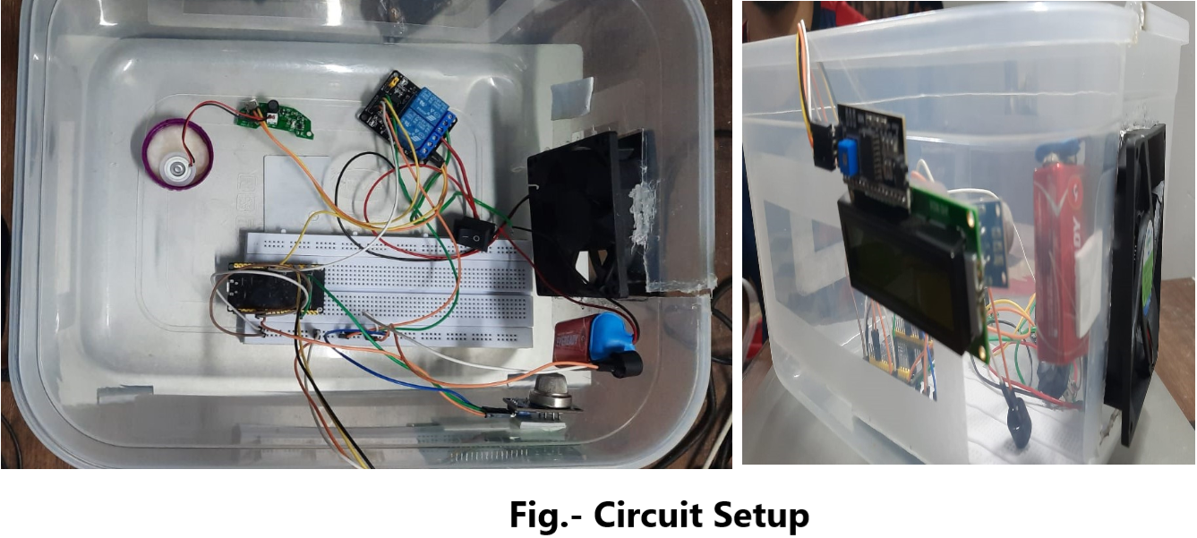
CIRCUIT DIAGRAM

Slide 10
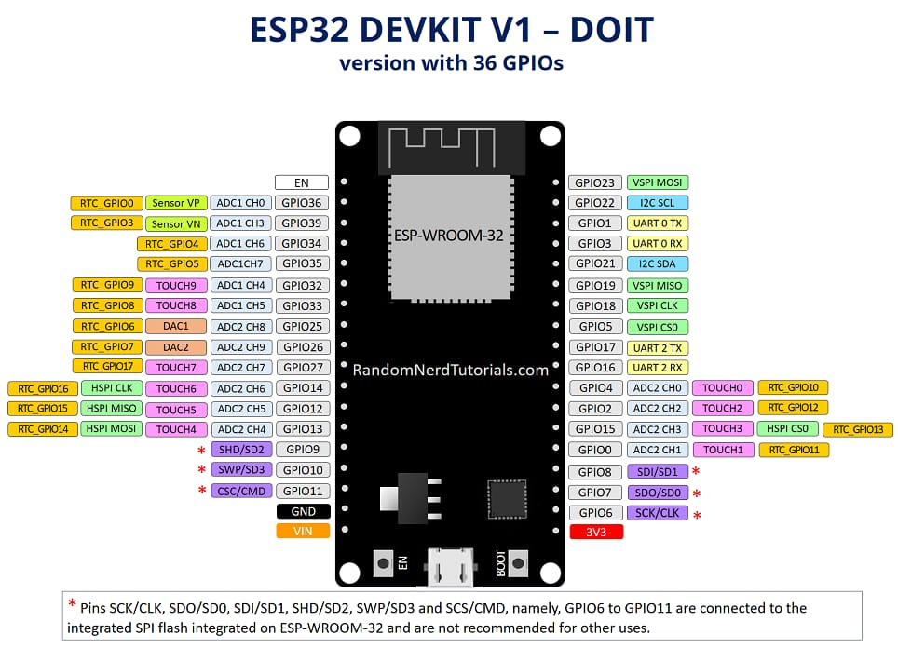
Pin Configuration Of ESP32

Slide 11
CIRCUIT EXPLANATION
For the sensor, connect the 3.3v pin of ESP32 to vcc pin of sensor. GND to GND , AO & DO pin of sensor to Input pins.
For the LCD display, Vcc to 5v, GND TO GND and SDA & SCL pin to digital input pins respectively.
For the buzzer , connect the positive pin to the digital input pin and negative pin to the GND pin of the ESP32.

Slide 12
Challenges
Accuracy of Sensors: One of the main challenges in air quality measurement is ensuring that the sensors used are accurate and reliable.
Maintenance: Maintenance can be a challenge in air quality measurement systems, as sensors can become dirty or damaged over time, requiring regular cleaning or replacement.
Collecting and storing large amounts of data can be a challenge, as can analyzing the data to identify trends and patterns.

Slide 13
Working Of The Project
The Gas sensor can sense NH3, NOx, alcohol, Benzene, smoke, CO2 and some other gases, so it is perfect gas sensor for our Air Quality Monitoring Project.
When we will connect it to ESP32 then it will sense the gases, and we will get the Pollution level in PPM.
The gas sensor gives the output in form of voltage levels and we need to convert it into PPM.
Whenever the value will increase 300 PPM, then the buzzer will start beeping and the LCD and webpage will display “Poor Air “ and activate the purifier.

Slide 14

Continued
The Anti-pollutant liquid we are going to use in the project.
Purification Percentage - 70%
Claims to be 100% organic.
It also helps to reduce dust particle as well as smoke.
It also helps to kill allergence.

Slide 15
Future Work
Any other application implementation of the topic.
Improvising it with some other specifications and outcomes
Development of portable devices where we can explore the development of portable air quality monitoring devices that individuals can carry with them
Integration with AI and Machine Learning: We can explore the possibility of integrating AI and machine learning algorithms into the system to enhance its ability to detect and predict air pollution levels.

Slide 16
CONCLUSION
A low-cost, high-fidelity air quality monitoring device was designed, built and tested. The device can gather data at every second and transmit data via Wi-Fi and notify the organization depending on the threshold level.
The device is low cost.The device provides a big humanitarian needs near schools near playgrounds in monitoring the quality of air the children breath, in factories or high traffic area where the emission is higher and affect many people, in developing countries and in places where the air quality is very poor and can be a health hazard by alerting the people to threatening levels of these realized pollutants.
Also, this prototype can be continued as low cost mobile device that anyone can use and it monitors the air along the path.

Slide 17



